Slide 1
SSW-810: Software Engineering Tools and Techniques
NoSQL Database Overview
Prof. Jim Rowland
Software Engineering
School of Systems and Enterprises

Slide 2
Acknowledgements
This lecture includes material from:
http://www.tutorialspoint.com/articles/what-is-nosql-and-is-it-the-next-big-trend-in-databases
http://www.w3resource.com/mongodb/nosql.php
http://api.mongodb.com/python/current/index.html
https://www.tutorialspoint.com/mongodb/index.htm
https://docs.mongodb.com/manual/

Slide 3

Today’s topics
Alternatives to Relational Databases
NoSQL databases
MongoDB
Compass
PyMongo

Slide 4
CRUD
All persistent storage solutions must support CRUD operations

Slide 5

RDBMS
Relational database technology is a great solution for many applications
Characteristics of good applications for RDBMS solutions:
Structured data
Data format can be defined in advance
Up to a few TBs of data
High availability transactions
High consistency
Transactions

Slide 6
RDBMS Alternatives
Big Data applications created a need for new solutions
Many applications involve large data sets (Exabytes)
E.g. imagine Google searching 30 trillion web pages 100 billion times a month from a MySQL database
Source: http://venturebeat.com/2013/03/01/how-google-searches-30-trillion-web-pages-100-billion-times-a-month/

Slide 7
NoSQL
Unstructured data vs structured relational data
NoSQL supports structured, semi-structured and unstructured data
Replace relational tables with flexible structures
Spread the data across clusters of computers
NoSQL solutions are schema-less
Priorities:
High performance
High availability
Scalability
http://www.smartdatacollective.com/sites/smartdatacollective.com/files/RDBMSvsNoSQL.jpeg

Slide 8
CAP Theorem (Brewer’s Theorem)
Distributed solutions require tradeoffs decided by business needs
Can’t have all three simultaneously
Consistency: Data is consistent across clients after an operation
NA
Partition Tolerance: system is able to function, even when communication between servers is unreliable
Availability: High system availability

Slide 9
Four NoSQL data models
Key Value, e.g. Redis
Document oriented, e.g. MongoDB
Column based, e.g. CouchDB
Graph based, e.g. Neo4j
Aggregate Objects
Relationships

Slide 10
Key/Value NoSQL databases
The key of the key/value pair is a unique value
Use the key to quickly access the data
Data may be a document, image, value, etc.
Some Key/Value solutions keep the data in memory for speed
Appropriate for read-mostly, read-intensive, large data repositories

Slide 11
Document oriented NoSQL databases
Store the entire document of key/value pairs
Typically JSON documents
”File” the document in the database
Use key to access the document
Store many types of document in a single collection
Store any kind or amount of data
No predefined schema
Very flexible to facilitate changes

Slide 12
Column Based NoSQL databases
Focus on column-oriented data
All values of a column are stored together in files
Very space efficient
Don’t store NULL values in the column
Better compression performance
Very efficient aggregation, e.g. sum, count, max, min, avg
Works well for data warehouses, BI, CRM, …

Slide 13
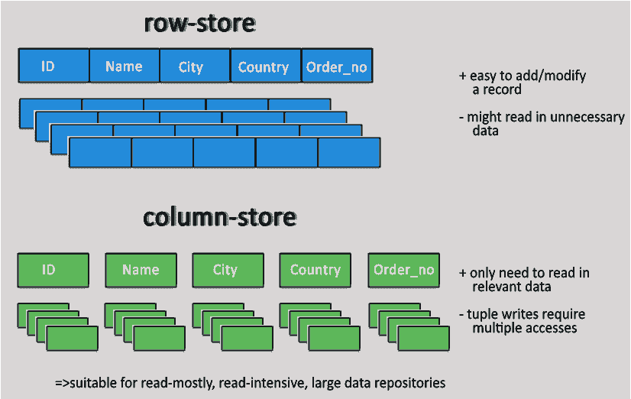
Row Store vs Column Store
Source: http://www.w3resource.com/mongodb/nosql.php

Slide 14
Graph based NoSQL databases
Store data with nodes, edges, and properties
Nodes (vertices) represent entities
Edges represent relationships
Edges link ordered pairs of nodes
Each node and edge has a unique identifier
Index of nodes and edges for fast lookup
Easy to explore relationships in the data

Slide 15
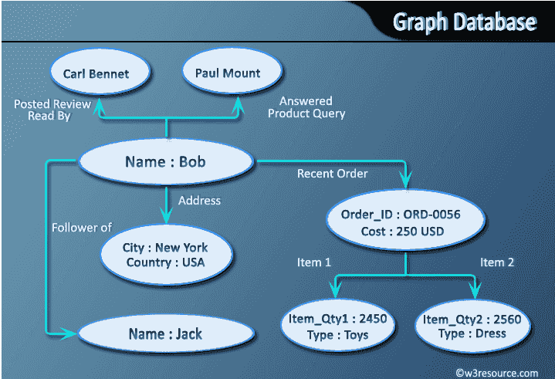
Graph Database
Source: http://www.w3resource.com/mongodb/nosql.php

Slide 16
MongoDB
Collections and Documents
Documents are stored as JSON-like objects
High performance and scalability
Optimized for scalable, distributed compute clusters
Provides data replication for reliability
Server
Database
Collection (Table)
Document (Row)
{Key : Value} (Value)
16

Slide 17
MongoDB Features
Data stored as JSON documents
{“CWID” : 123,
“Name” : “Wright, D”,
“Major” : “SFEN”,
“Grades” : {“SSW 540” : “A”, “SSW 533: “B”} }
No fixed schema as in RDBMS
Each document may have different attributes and types
Add, rename, or remove attributes easily at any time

Slide 18
MongoDB Features (CRUD)
Queries return all documents matching the query
{“Major” : “SFEN” }
Return all documents containing “Major” == “SFEN”
Display a subset of document fields
Sort results
Aggregations: $sum, $min, $max,
Update documents
Insert documents
Remove documents

Slide 19
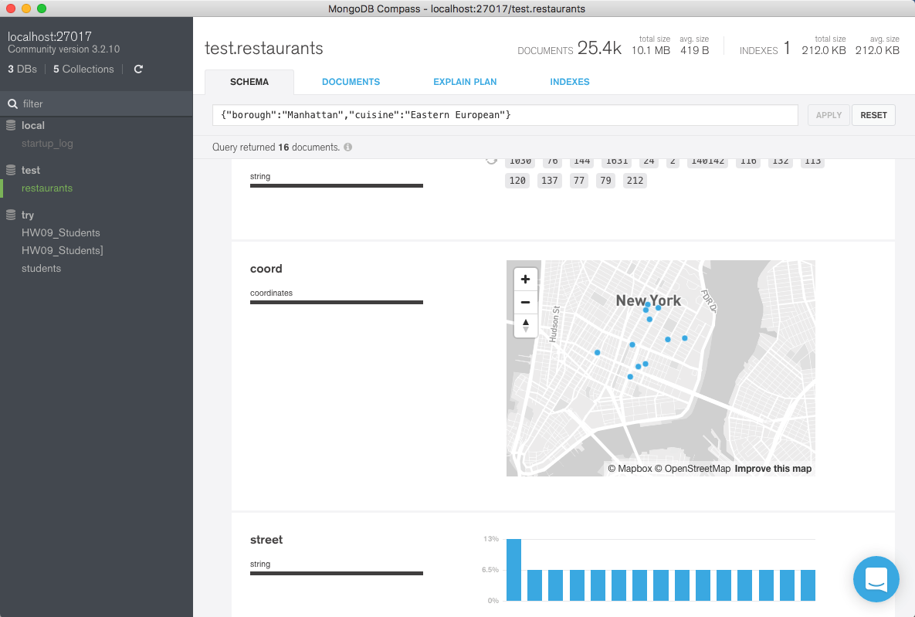
MongoDB Canvas
Explore MongoDB databases easily
Eastern European Cuisine in Manhattan
Eastern European Cuisine in Manhattan

Slide 20
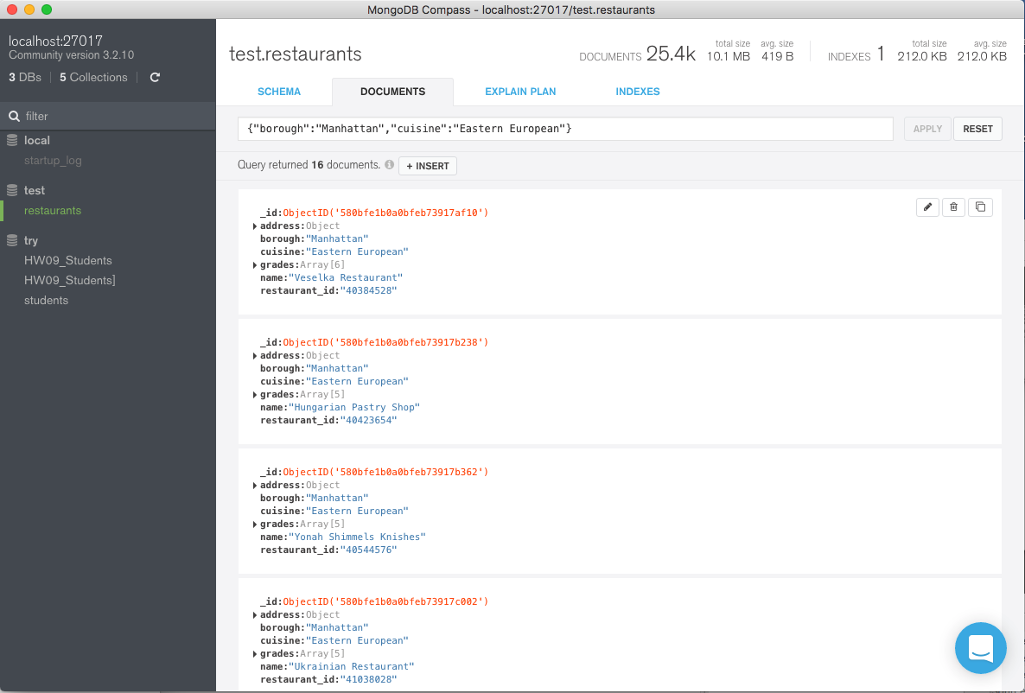
MongoDB Canvas
Explore MongoDB databases easily
Eastern European Cuisine in Manhattan
Documents with Eastern European Cuisine in Manhattan

Slide 21
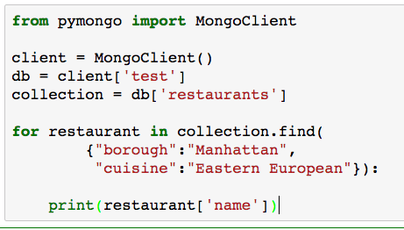
Accessing MongoDB from Python
PyMongo provides a powerful interface to MongoDB
PyMongo Tutorial:
http://api.mongodb.com/python/current/index.html

Slide 22
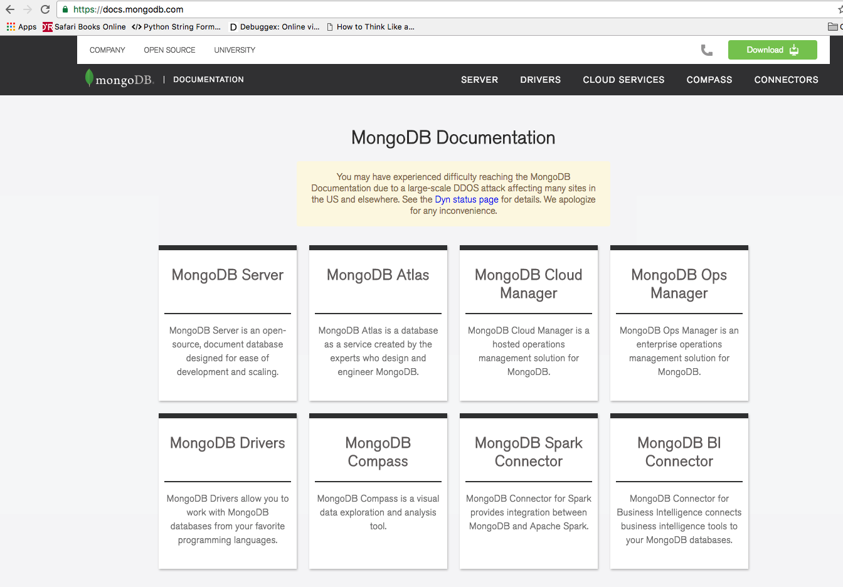
Getting Started with MongoDB
https://docs.mongodb.com
Getting Started Documentation
MongoDB Server
Compass GUI

Slide 23
NoSQL Summary
NoSQL database solutions offer alternatives to RDBMS
More flexible
More scalable to support very large datasets
Interesting alternative to RDBMS

Slide 24

Questions?

